Slide 1
Flexbox
Ridiculously
E
A
S
Y
Layouts
with
https://github.com/ecarlisle/Easy-Layouts-with-Flexbox
Eric Carlisle
@eric_carlisle

Slide 2








me, myself, and i
who?
what?
where?
how?
Eric Carlisle
UI / UX Geek @
Baltimore, MD

Slide 3
what the flex is a flexbox?
A CSS layout mode.

Slide 4
what the flex is a flexbox?
A CSS layout mode.
/* Instead of block, inline, table, etc… */
.something {
display: flex;
}

Slide 5
what the flex is a flexbox?
A CSS layout mode.
/* Instead of block, inline, table, etc… */
.something {
display: flex;
}
Flexible space allocation relationships between parent & child elements.

Slide 6
what the flex is a flexbox?
A CSS layout mode.
/* Instead of block, inline, table, etc… */
.something {
display: flex;
}
Flexible space allocation relationships between parent & child elements.
Multi-axis – elements stack horizontally or vertically!
Let’s see that, shall we?

Slide 7
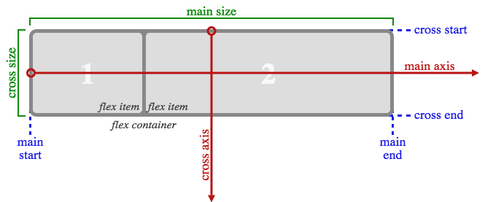
what the flex is a flexbox?
Core Concepts:
There is always a main & cross axis.
Each have a start, end, and size.
Axis direction depends on flex-direction property.

Slide 8
general benefits?
W3C Standard! No libraries needed!
Once you grok it, it’s amazingly easy.
Opportunity for tremendous creativity.

Slide 9
layout benefits?
Gets us away from countless floats and clears!
Override source order with CSS!
Vertical positioning without hacks!
Equal heights (e.g. columns)

Slide 10
layout-benefits?
Elements “flex” to fit available space.
Custom responsive layouts can be a cakewalk!
More opportunity for the semantic.

Slide 11

final results?
PURE AWESOMENESS!

Slide 12
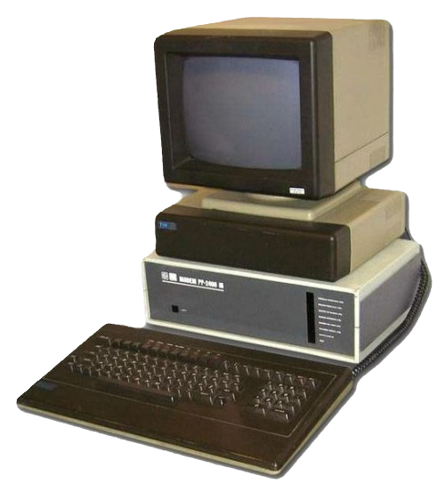
what’s the rub?
There’s been some history.
/* 2009 initial version */
display: box;
/* 2011-12 “tweener” version */
display: flexbox;
/* Present day */
display: flex;

Slide 13

what’s the rub?
“Holy Browser Prefixes, Batman!”
/* Webkit */
display: "-webkit-flex”;
/* Mozilla */
display: "-moz-flex;
/* IE10 */
display: "-ms-flexbox";
/* IE11 */
display: "-ms-flex”;
/* W3C */
display: “flex”

Slide 14


what’s the rub?
“Holy Browser Prefixes, Batman!”
Recommended Approach:
Use Preprocessor Mixins!
/* Webkit */
display: "-webkit-flex”;
/* Mozilla */
display: "-moz-flex;
/* IE10 */
display: "-ms-flexbox";
/* IE11 */
display: "-ms-flex”;
/* W3C */
display: “flex”
(For this presentation, I’ll use FireFox Developer Edition)

Slide 15
what’s the rub?
It works in everything except…
Guess!

Slide 16

what’s the rub?
It works in everything except…
“The browser that must not be named.”

Slide 17
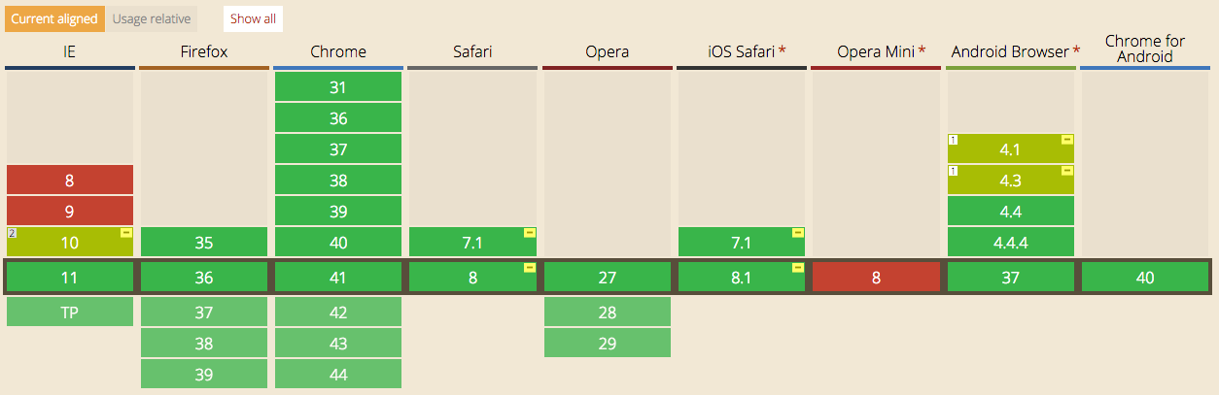
what’s the rub?
But in All Fairness…
http://caniuse.com/#feat=flexbox
Clear-ish support across the board
IE10 supports the 2012 version (as per current spec)
Most current browsers still have flexbox “personality”

Slide 18

what’s the rub?
OK, not so bad, right?
“See, I’m not such a bad guy after all!”

Slide 19
what’s the rub?
It’s not exactly done done done yet.
Editor’s Draft – March 2nd, 2015
http://dev.w3.org/csswg/css-flexbox/
Last Call Working Draft – September 25th 2014
http://www.w3.org/TR/css3-flexbox/

Slide 20

what’s the rub?
It’s not exactly done done done yet.
Editor’s Draft – March 2nd, 2015
http://dev.w3.org/csswg/css-flexbox/
Last Call Working Draft – September 25th 2014
http://www.w3.org/TR/css3-flexbox/
“Standards are Paper.”
-- Linus Torvalds

Slide 21
Parents & Children

Slide 22
Parent Properties
display:
flex-direction:
flex-wrap:
Justify-content:
Align-items:
Align-content:
Flex or flex-inline?
Row? Column? Which way?
Line break? Which way?
Space allocation of the stretch?
Alignment on main axis?
Align wrapped content on the cross axis?

Slide 23
Child Properties
order:
flex-grow:
flex-shrink:
flex-basis:
align-self:
Source order or something else?
Remaining space allocation on growth?
Remaining space allocation on shrink?
What is the “remaining” space?
Do I really want to align that way?

Slide 24
Q/A
Eric Carlisle
@eric_carlisle
eric@ericcarlisle.com

